Slide 1
Cloud Computing Security
Ohio Information Security Forum
July 16th, 2011
James Walden, Ph.D.
Northern Kentucky University

Slide 2
Topics
What is Cloud Computing?
The Same Old Security Problems
Virtualization Security
New Security Issues and Threat Model
Data Security

Slide 3
What is Cloud Computing?

Slide 4
What is Cloud Computing?
“Cloud computing is a model for enabling convenient, on-demand network access to a shared pool of configurable computing resources (e.g., networks, servers, storage, applications, and services) that can be rapidly provisioned and released with minimal management effort or service provider interaction.”
NIST definition of Cloud Computing

Slide 5
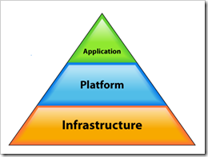
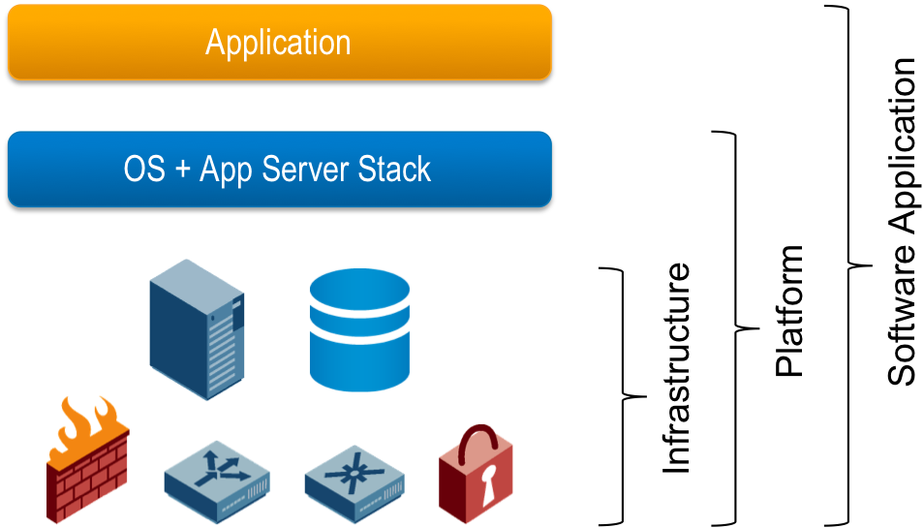
Cloud Service Architectures as Layers
Notes:
http://onsaas.net/2008/06/03/defining-saas-paas-iaas-etc/

Slide 6
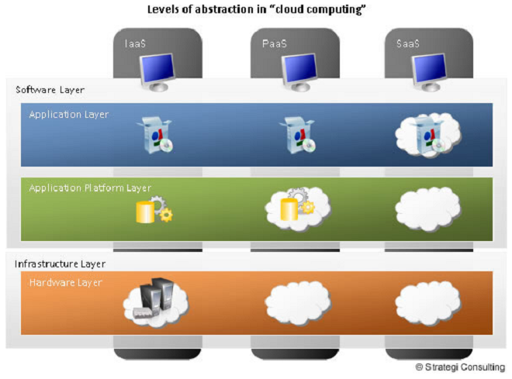
Cloud Service Models Abstraction Layers

Slide 7
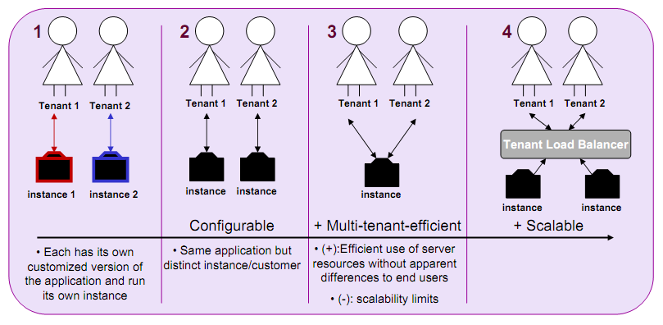
Multi-Tenancy

Slide 8
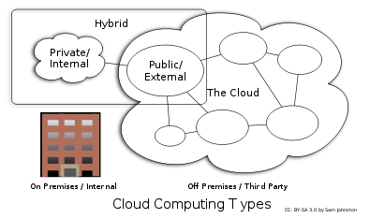
Cloud Deployment Architectures

Slide 9
Same Old Security Issues
Data Loss
Downtimes
Phishing
Password Cracking
Botnets and Other Malware

Slide 10
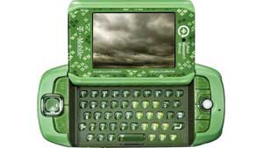
Data Loss
"Regrettably, based on Microsoft/Danger's latest recovery assessment of their systems, we must now inform you that personal information stored on your device—such as contacts, calendar entries, to-do lists or photos—that is no longer on your Sidekick almost certainly has been lost as a result of a server failure at Microsoft/Danger."
Notes:
http://arstechnica.com/business/news/2009/10/t-mobile-microsoftdanger-data-loss-is-bad-for-the-cloud.ars

Slide 11
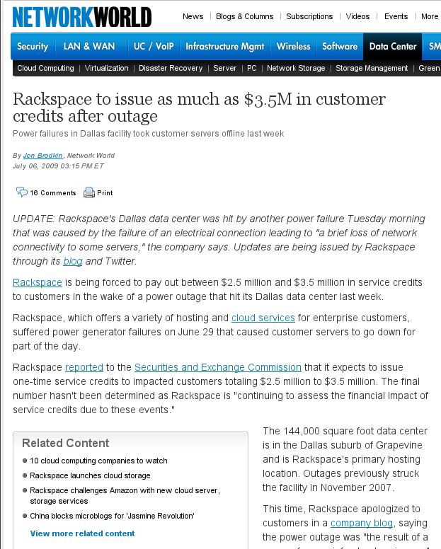
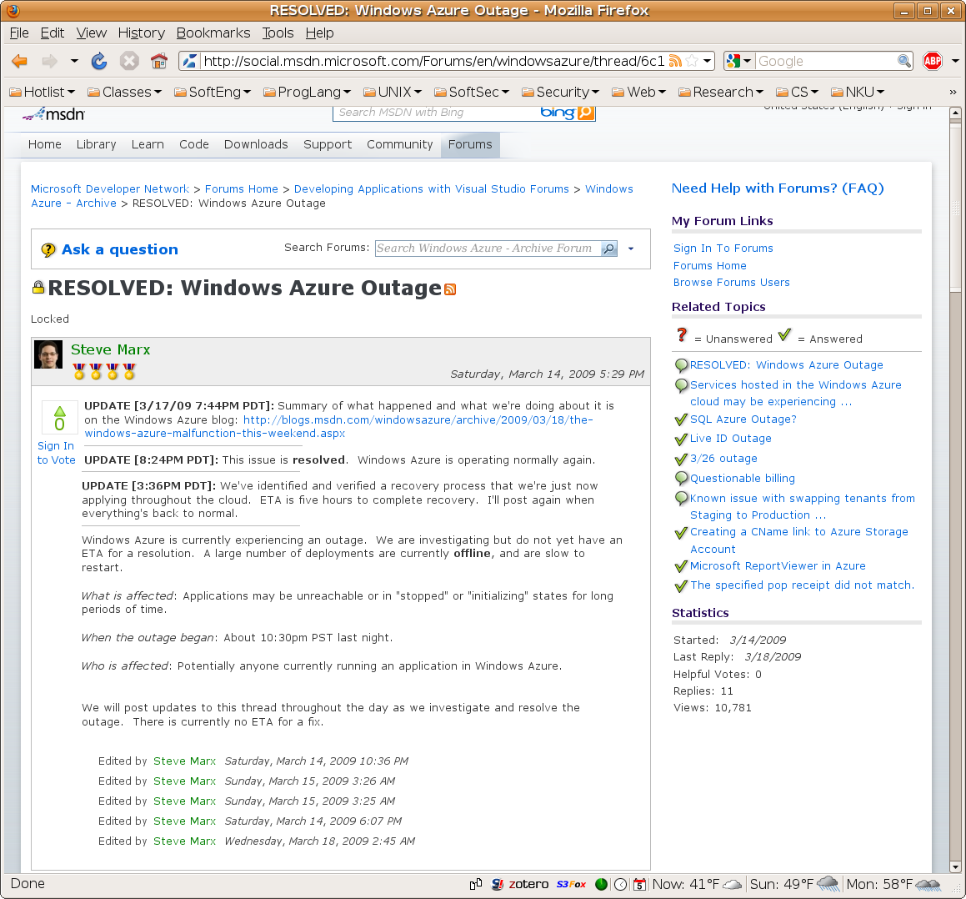
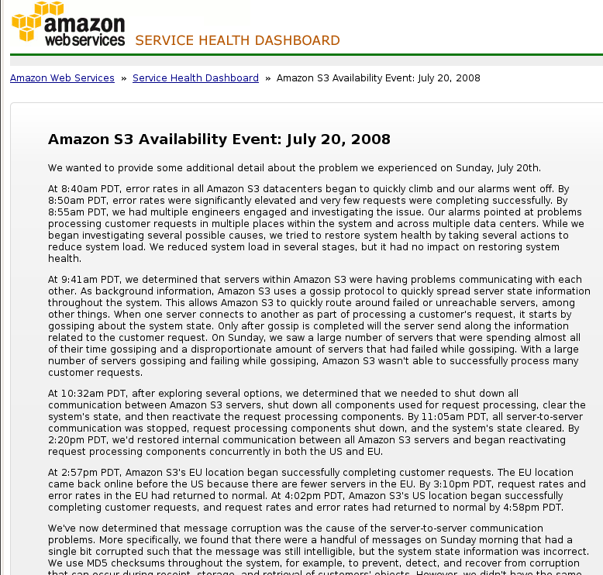
Downtimes

Slide 12
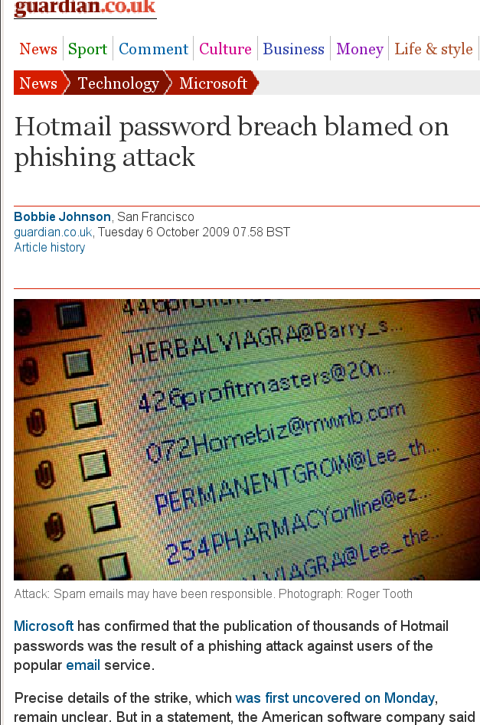
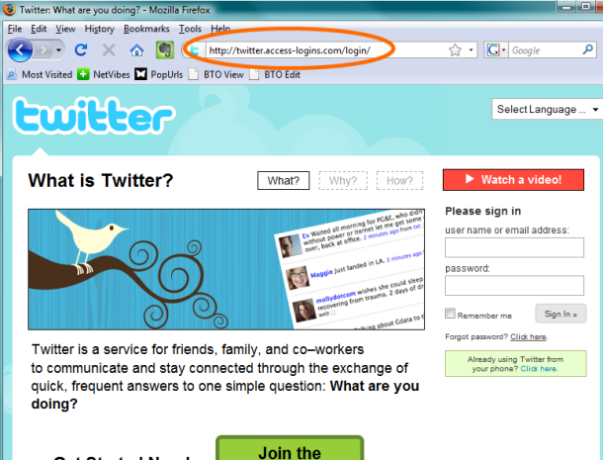
Phishing
“hey! check out this funny blog about you...”
Notes:
http://news.cnet.com/twitter-phishing-scam-may-be-spreading/

Slide 13
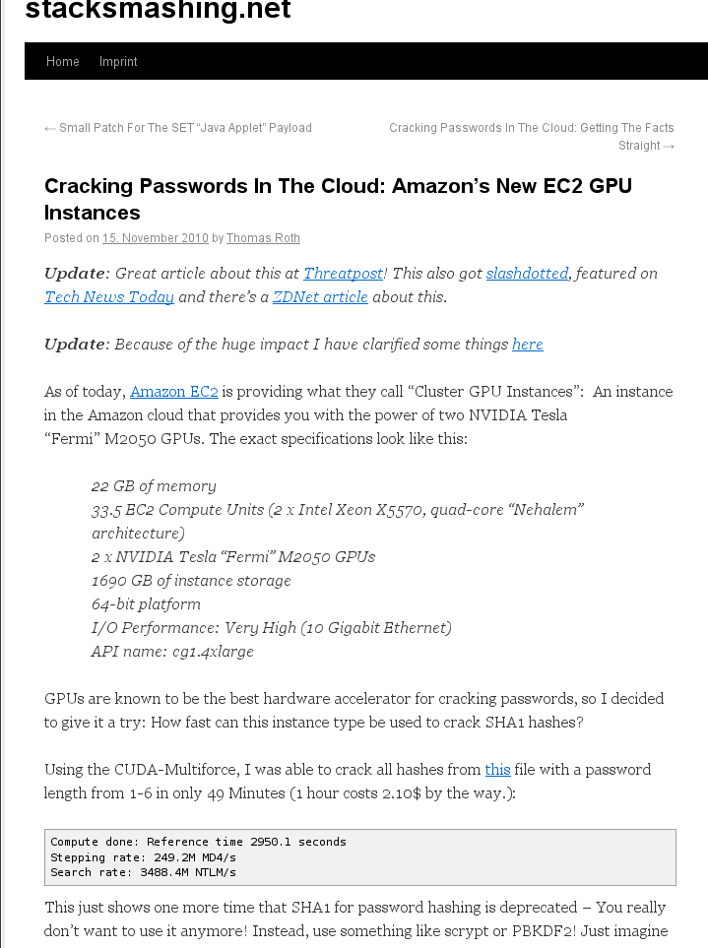
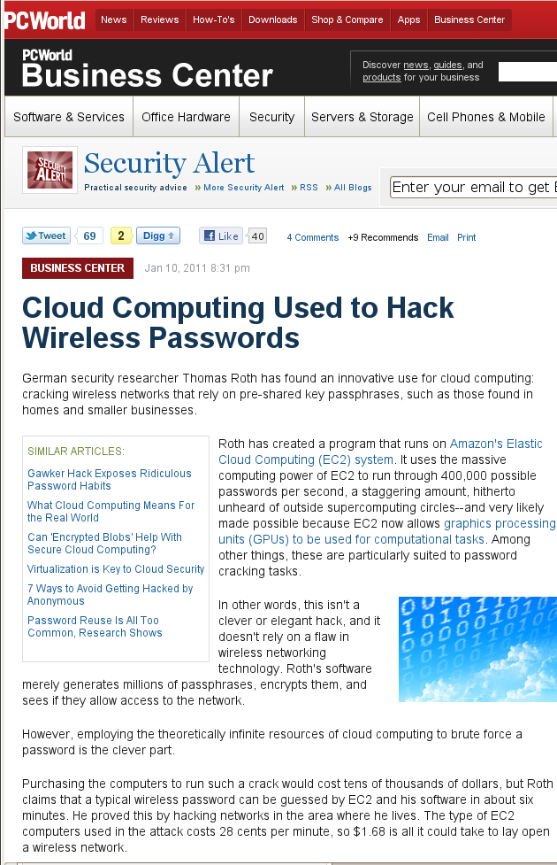
Password Cracking

Slide 14
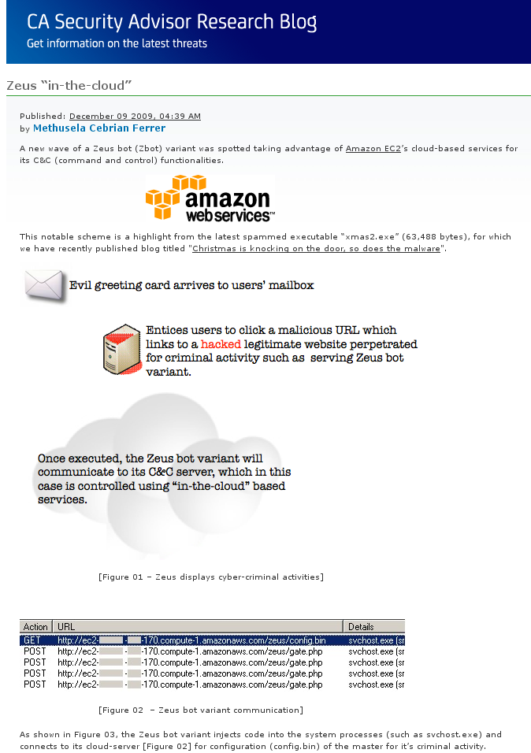
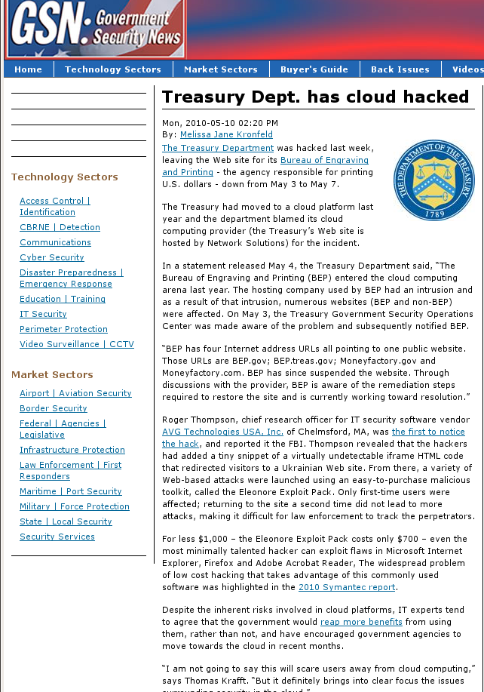
Botnets and Malware
Notes:
http://community.ca.com/blogs/securityadvisor/archive/2009/12/09/zeus-in-the-cloud.aspx

Slide 15
Virtualization Security
Features
Isolation
Snapshots
Issues
State Restore
Complexity
Scaling
Transience
Data Lifetime

Slide 16
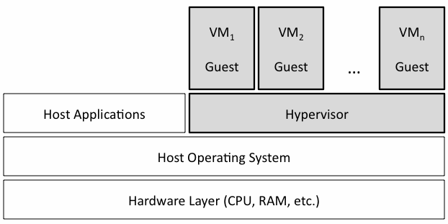
Virtualization Security Features: Isolation
Using a VM for each application provides isolation
More than running 2 apps on same server.
Less than running on 2 physical servers
Notes:
http://www1.cse.wustl.edu/~jain/cse571-09/ftp/vmsec/index.html

Slide 17
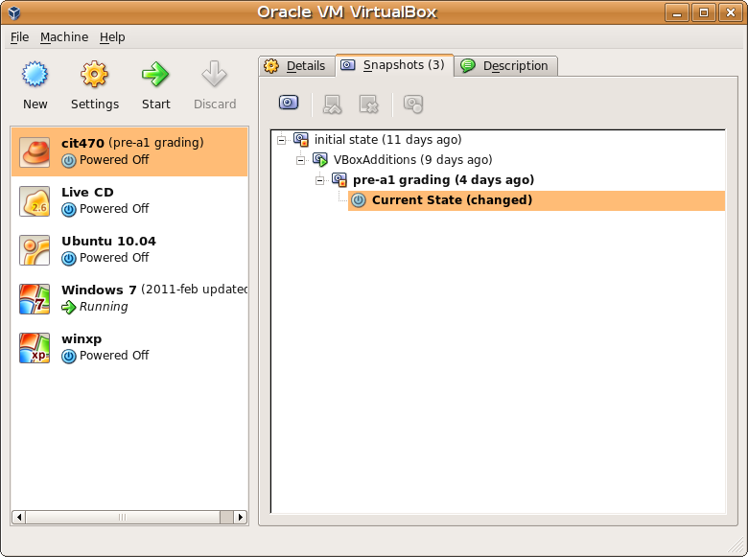
Virtualization Security Features: Snapshot
VMs can record state.
In event of security incident, revert VM back to an uncompromised state.
Must be sure to patch VM to avoid recurrence of compromise.

Slide 18
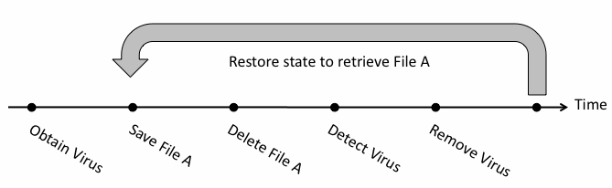
State Restore
VMs can be restored to an infected or vulnerable state using snapshots.
Patching becomes undone.
Worms persist at low level forever due to reappearance of infected and vulnerable VMs.
Notes:
http://www1.cse.wustl.edu/~jain/cse571-09/ftp/vmsec/index.html

Slide 19
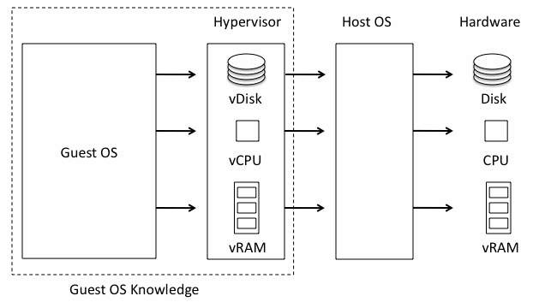
Complexity
Hypervisor may be simple or not, but
It is often another layer on top of host OS, adding complexity and vulnerabilities.

Slide 20
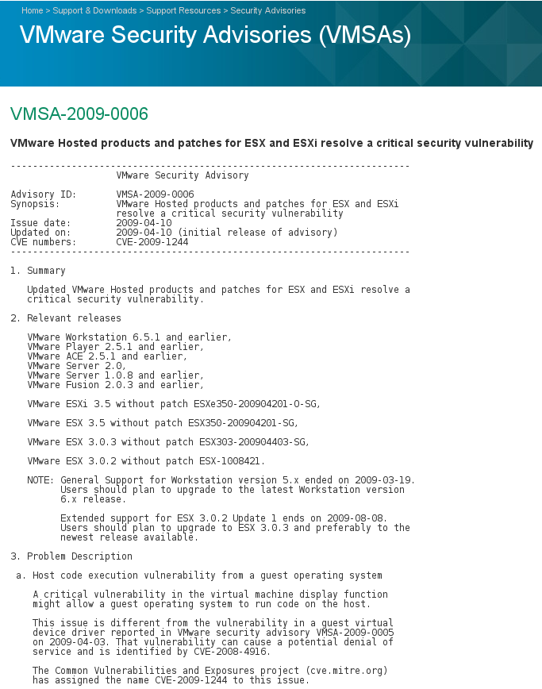
Hypervisor Security
Vulnerability consequences
Guest code execution with privilege
VM Escape (Host code execution)
Vendor | CVEs
KVM | 32
QEMU | 23
VirtualBox | 9
VMware | 126
Xen | 86
Xen CVE-2008-1943
VBox CVE-2010-3583

Slide 21
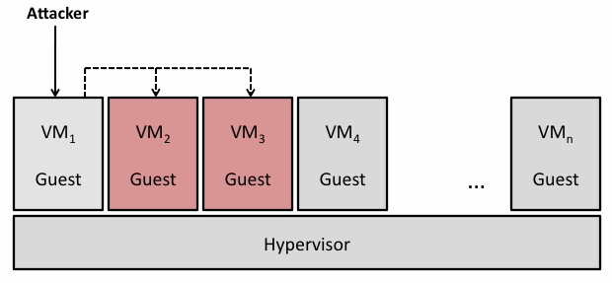
Inter-VM Attacks
Attack via shared clipboard
http://www.securiteam.com/securitynews/5GP021FKKO.html
Use shared folder to alter other VM’s disk image
CVE-2007-1744
Notes:
http://www1.cse.wustl.edu/~jain/cse571-09/ftp/vmsec/index.html

Slide 22
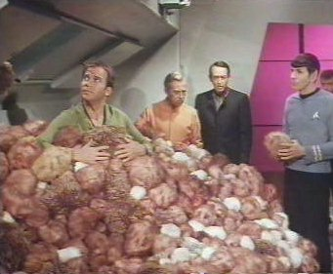
Scaling
Growth in physical machines limited by budget and setup time.
Adding a VM is easy as copying a file, leading to explosive growth in VMs.
Rapid scaling can exceed capacity of organization’s security systems.

Slide 23
Transience
Users often have specialized VMs.
Testing
Different app versions
Demos
Sandbox
that are not always up, preventing network from converging to a known state.
Infected machines appear, attack, then disappear from the network before can be detected.
Vulnerable systems likewise appear too briefly to be detected and patched.

Slide 24
Data Lifetime
Although data was correctly sanitized from VM disk and/or memory, snapshots can retain multiple copies of both VM memory and disk data.

Slide 25
New Security Issues
Accountability
No Security Perimeter
Larger Attack Surface
New Side Channels
Lack of Auditability
Regulatory Compliance
Data Security

Slide 26
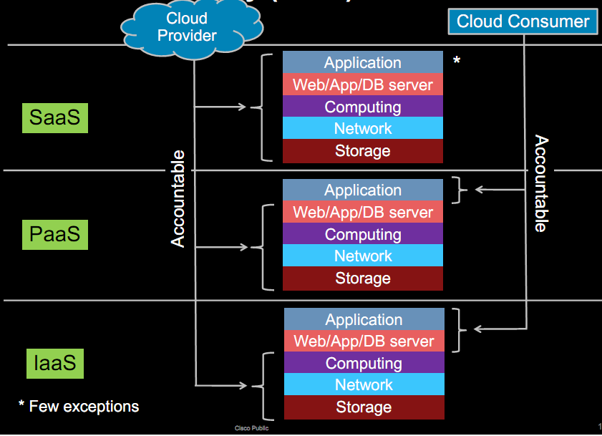
Accountability

Slide 27

No Security Perimeter
Little control over physical or network location of cloud instance VMs
Network access must be controlled on a host by host basis.

Slide 28
Larger Attack Surface
Cloud Provider
Your Network

Slide 29
New Side Channels
You don’t know whose VMs are sharing the physical machine with you.
Attackers can place their VMs on your machine.
See “Hey, You, Get Off of My Cloud” paper for how.
Shared physical resources include
CPU data cache: Bernstein 2005
CPU branch prediction: Onur Aciiçmez 2007
CPU instruction cache: Onur Aciiçmez 2007
In single OS environment, people can extract cryptographic keys with these attacks.

Slide 30
Lack of Auditability
Only cloud provider has access to full network traffic, hypervisor logs, physical machine data.
Need mutual auditability
Ability of cloud provider to audit potentially malicious or infected client VMs.
Ability of cloud customer to audit cloud provider environment.

Slide 31
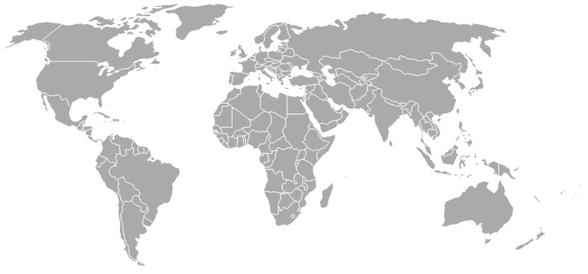
Regulatory Compliance

Slide 32
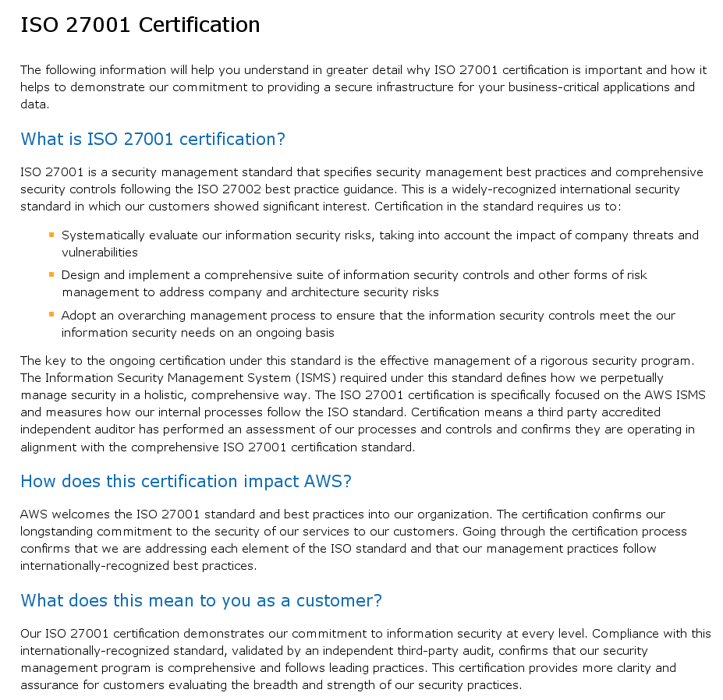
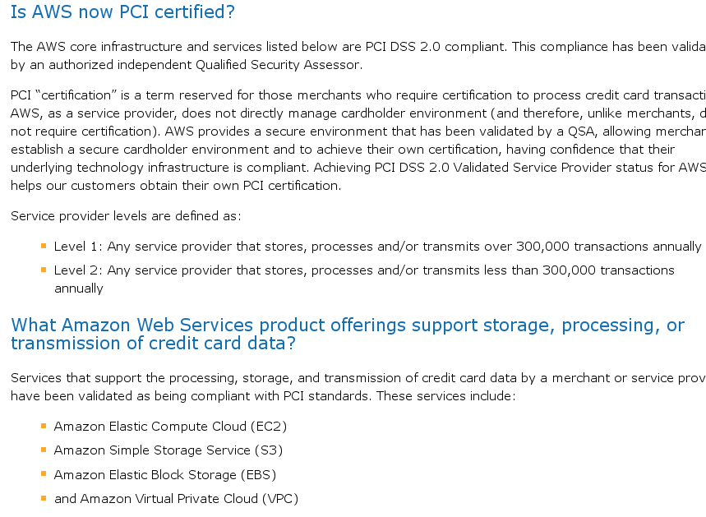
Certifications

Slide 33
Data Security
Data in Transit
Data at Rest
Data in Processing
Data Remanence
Homomorphic Encryption

Slide 34
Data Security
Symmetric Encryption | Homomorphic Encryption | SSL
MAC | Homomorphic Encryption | SSL
Redundancy | Redundancy | Redundancy
Confidentiality
Integrity
Availability
Storage
Processing
Transmission
Plus data remanence.

Slide 35
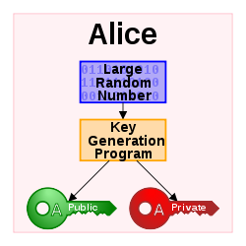
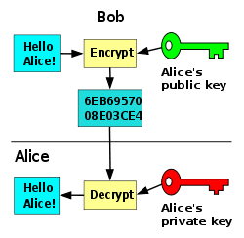
Public Key Cryptography
Notes:
http://en.wikipedia.org/wiki/Public-key_cryptography

Slide 36
Homomorphic Public-key Encryption
Public-key Crypto with additional procedure: Eval
c* ← Eval_{pk}(Π, c₁,…,c_{n})
Π a Boolean circuit with ADD, MULT mod 2
Encryption of inputs m₁,…,m_{n} to Π
Encryption of output value m*=Π(m₁,…,m_{n})
Homomorphic encryption slides borrowed from people.csail.mit.edu/shaih/pubs/IHE-S-and-P-day.ppt

Slide 37

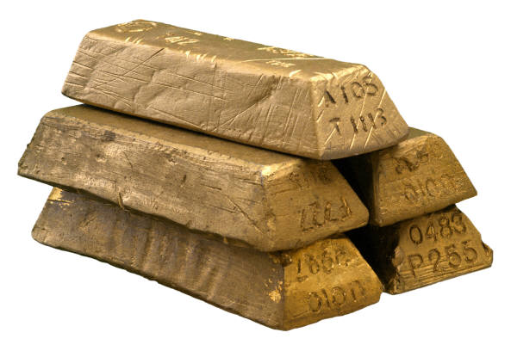

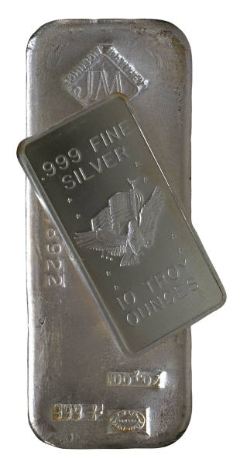
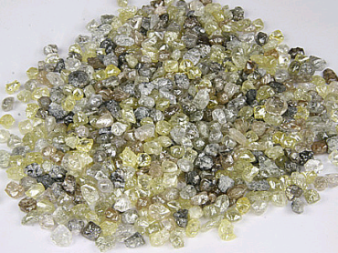
An Analogy: Alice’s Jewelry Store
Alice’s workers need to assemble raw materials into jewelry
But Alice is worried about theft
How can the workers process the raw materials without having access to them?

Slide 38
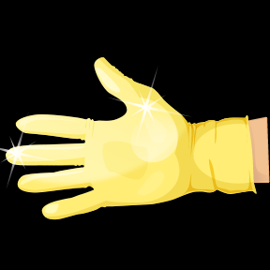


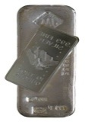

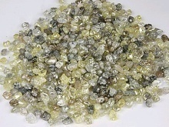
An Analogy: Alice’s Jewelry Store
Alice puts materials in locked glove box
For which only she has the key
Workers assemble jewelry in the box
Alice unlocks box to get “results”

Slide 39
References
Yanpei Chen, Vern Paxson and Randy H. Katz, “What’s New About Cloud Computing Security?” Technical Report No. UCB/EECS-2010-5, http://www.eecs.berkeley.edu/Pubs/TechRpts/2010/EECS-2010-5.html, Jan. 20, 2010.
Tal Garfinkel and Mendel Rosenblum. “When virtual is harder than real: security challenges in virtual machine based computing environments.” In Proceedings of the 10th conference on Hot Topics in Operating Systems - Volume 10 (HOTOS'05), Vol. 10. USENIX Association.
Craig Gentry. “Computing arbitrary functions of encrypted data.” In Commun. ACM 53, 3 (March 2010), 97-105. DOI=10.1145/1666420.1666444
Doug Hyde. “A Survey on the Security of Virtual Machines.” http://www1.cse.wustl.edu/~jain/cse571-09/ftp/vmsec/index.html, 2007.
Tim Mather, Subra Kumaraswamy, and Shahed Latif, Cloud Security and Privacy: An Enterprise Perspective on Risks and Compliance, O’Reilly Media, 2009.
T. Ristenpart, E. Tromer, H. Shacham, and S. Savage. “Hey, You, Get Off of My Cloud! Exploring Information Leakage in Third-Party Compute Clouds.” In S. Jha and A. Keromytis, eds., Proceedings of CCS 2009, pages 199–212. ACM Press, Nov. 2009.
NIST, DRAFT A Definition of Cloud Computing, http://csrc.nist.gov/publications/drafts/800-145/Draft-SP-800-145_cloud-definition.pdf, January 28, 2011.
NIST, DRAFT Guidelines on Security and Privacy in Public Cloud Computing, http://csrc.nist.gov/publications/drafts/800-144/Draft-SP-800-144_cloud-computing.pdf, January 28, 2011.

